Slide 1
FIRST Long Island Presented by School-Business Partnerships of Long Island, Inc.

Slide 2
Kick Off 2017
FIRST Tech Challenge
Core Values
Notes:
Lisa

Slide 3
Core Values
FIRST Tech Challenge is MORE THAN ROBOTS! While competing, students develop personal and professional skills they will be able to rely on throughout their life.
FIRST asks everyone who participates in FIRST Tech Challenge to uphold the following values
Notes:
Brian

Slide 4
Integrity
We act with integrity
We do the work to get the job done with guidance from our coaches and mentors
What we learn is more important than what we win
Notes:
Brian

Slide 5
Integrity
FIRST Tech Challenge is foremost an educational program that inspires students to pursue further educational and professional opportunities. This begins with encouraging students to do the work themselves with guidance from mentors and coaches. The students build self-confidence, knowledge, and life skills by prioritizing their learning over competing/winning.
Notes:
Brian

Slide 6
Teamwork
We are a team
We respect each other in the best spirit of teamwork
Notes:
Lisa

Slide 7
Teamwork
In FIRST Tech Challenge, teams work together to overcome obstacles and meet challenges, while learning from, and interacting with their peers and adult Mentors. Students develop a greater appreciation of science and technology and how they might use that knowledge to impact the world around them in a positive manner. Together, they cultivate life skills such as:
Planning, brainstorming, and creative problem-solving
Research and technical skills
Collaboration and teamwork
Appreciation of differences and respect for the ideas and contributions of others
Notes:
Lisa

Slide 8
Coopertition
We honor the spirit of friendly competition
We behave with courtesy and compassion for others at all times
Notes:
Brian

Slide 9
Coopertition
Coopertition produces innovation.
At FIRST, Coopertition is displaying unqualified kindness and respect in the face of fierce competition. Coopertition is founded on the concept and a philosophy that teams can and should help and cooperate with each other even as they compete. Coopertition involves learning from teammates. It is teaching teammates. It is learning from Mentors. And it is managing and being managed. Coopertition means competing always, but assisting and enabling others when you can.
Notes:
Brian

Slide 10
Gracious Professionalism
We display Gracious Professionalism in everything we do
Notes:
Lisa

Slide 11
Gracious Professionalism
Gracious Professionalism is not clearly defined for a reason. It has different meanings to everyone. Some possible meanings of Gracious Professionalism include:
• Gracious attitudes and behaviors are win-win.
• Gracious folks respect others and let that respect show in their actions.
• Gracious Professionals make valued contributions in a way that is pleasing to others and to themselves.
Notes:
Lisa

Slide 12
Gracious Professionalism
In FIRST, Gracious Professionalism teaches teams and student participants:
• Learn to be strong competitors, but also treat one another with respect and kindness in the process.
• Avoid leaving anyone feeling as if they are excluded or unappreciated.
• Knowledge, pride and empathy should be comfortably and genuinely blended.
Notes:
Brian

Slide 13
Gracious Professionalism
“In the end, Gracious Professionalism is part of everyday life. When professionals use their knowledge in a gracious manner and individuals act with integrity and sensitivity, everyone wins, and society benefits.”
- Dr. Woodie Flowers
Notes:
Brian

Slide 14
Community
We share our experiences with others
We encourage others to adopt these values
Notes:
Lisa

Slide 15
Community - Outreach
Teams should help their community understand FIRST, the FIRST Tech Challenge, and the team itself.
Teams should make a collective effort to make FIRST known throughout their school and community, and spark others to embrace the culture of FIRST.
Notes:
Lisa

Slide 16
Community - Spirit
Teams should represent the essence of the FIRST Tech Challenge competition through team building, team spirit and enthusiasm!
Notes:
Brian
Team Image

Slide 17
Community - Engagement
Teams should connect with their local STEM community. A true FIRST team is more than a sum of its parts, and recognizes that engaging their local STEM community plays an essential part in their success.
Teams should seek and recruit subject matter experts and explore the opportunities available in the world of STEM.
Notes:
Lisa

Slide 18
Fun!
We have fun!
Notes:
Brian & Lisa

Slide 19
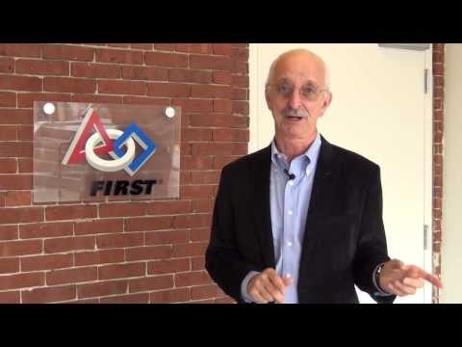
References
FIRST Vision and Mission Statement
2017-2018 FIRST® Tech Challenge Game Manual Part 1
Notes:
Brian

